Slide 1







WEBSITE CUSTOMER CHURN PREDICTION
Prepared by:
ARUN KUMAR A R
SOUMYA RANJAN

Slide 2





Today's agenda
Project recap Problem statement Process
Insights Summary

Slide 3



In this churn prediction analysis project, our objective was to develop a predictive model to identify
Project Recap
customers who are at risk of churning from a website. The dataset included various customer attributes, such as age, gender, membership details, transaction history, and more. Our goal was to leverage this data to build a model that can accurately predict customer churn.

Slide 4





1
Problem Statement
2
Data Preprocessing
Process
3
Data Visualization
4
Handling Outliers
Data Cleaning
5
6
Feature Scaling
7
Model Training and Evaluation
8
Model Comparison and Saving

Slide 5


Attributes
Age: The age of the customer.
Gender: The gender of the customer.
Security number: A unique security number that is used to identify a person.
Region category: The region that the customer belongs to.
Membership category: The category of the membership that the customer is using.
Joining date: The date when the customer became a member.
Joined through referral: Whether the customer joined using any referral code or ID..
Referral ID: A referral ID.
Preferred offer types: The type of offer that the customer prefers.
Age: The age of the customer.
Gender: The gender of the customer.
Security number: A unique security number that is used to identify a person.
Region category: The region that the customer belongs to.
Membership category: The category of the membership that the customer is using.
Joining date: The date when the customer became a member.
Joined through referral: Whether the customer joined using any referral code or ID.
Referral ID: A referral ID.
Preferred offer types: The type of offer that the customer prefers.
Medium of operation: The medium of operation that the customer uses for transactions.
Internet option: The type of internet service that the customer uses.
Last visit time: The last time the customer visited the website.
Days since last login: The number of days since the customer last logged into the website.
Average time spent: The average time spent by the customer on the website.
Average transaction value: The average transaction value of the customer.
Average frequency login days: The number of times a customer has logged in to the website.
Points in wallet: The points awarded to a customer on each transaction.
Used special discount: Whether the customer uses special discounts offered.
Offer application preference: Whether the customer prefers offers.
Past complaint: Whether the customer has raised any complaints.
Complaint status: Whether the complaints raised by the customer was resolved.
Feedback: The feedback provided by the customer.
Churn risk score: A score that indicates whether the customer is likely to churn (1) or not churn (0).

Slide 6




Customer churn rate is a measure that
quantifies the number of customers who leave
Problem
a business during a specified period of time.
Identifying and predicting churn is the necessary first step to keeping these customers and offering better products and services.

Slide 7
The code begins by importing necessary libraries and suppressing warnings.
Pandas and NumPy libraries are imported for data manipulation and analysis.
The dataset is loaded from a CSV file using Pandas.
Data dimensions, statistical summary, and data types are explored.
Data Preprocessing

Slide 8
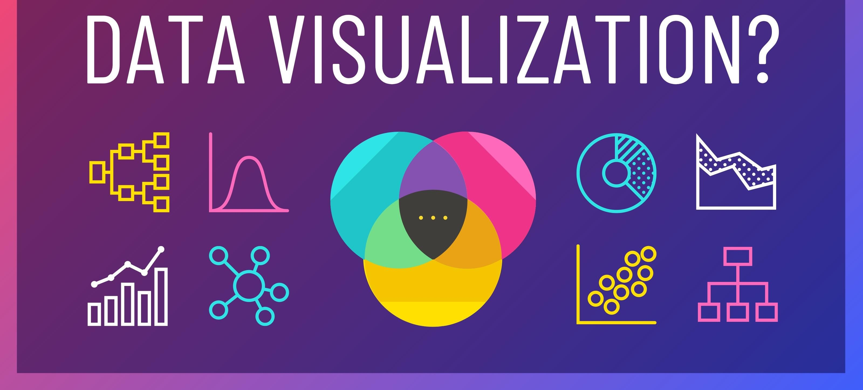

Slide 9
Seaborn and Matplotlib libraries are imported for data visualization.
A heatmap is plotted to show the correlation between features.
Count plots and boxplots are used to visualize the distribution of churn risk with respect to categorical and continuous variables.
Data Visualization

Slide 10
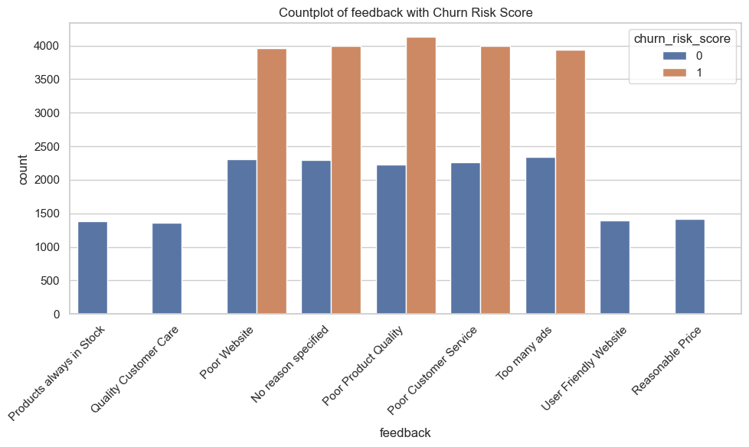
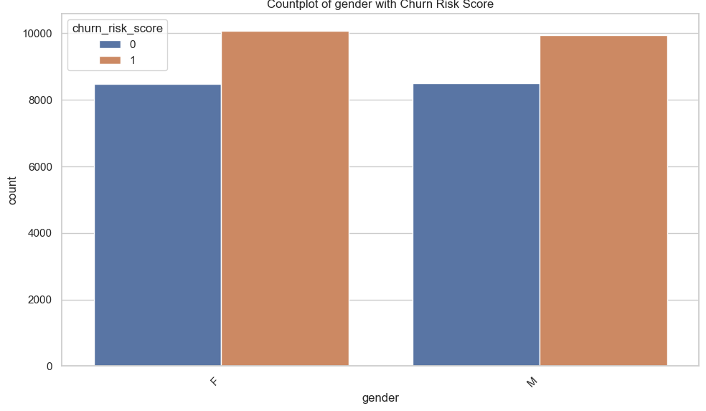



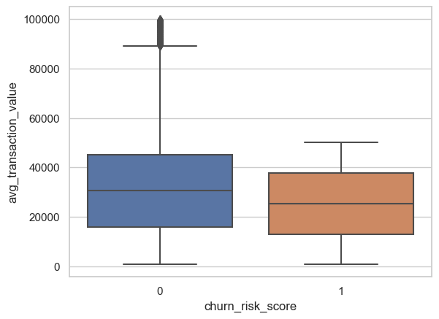
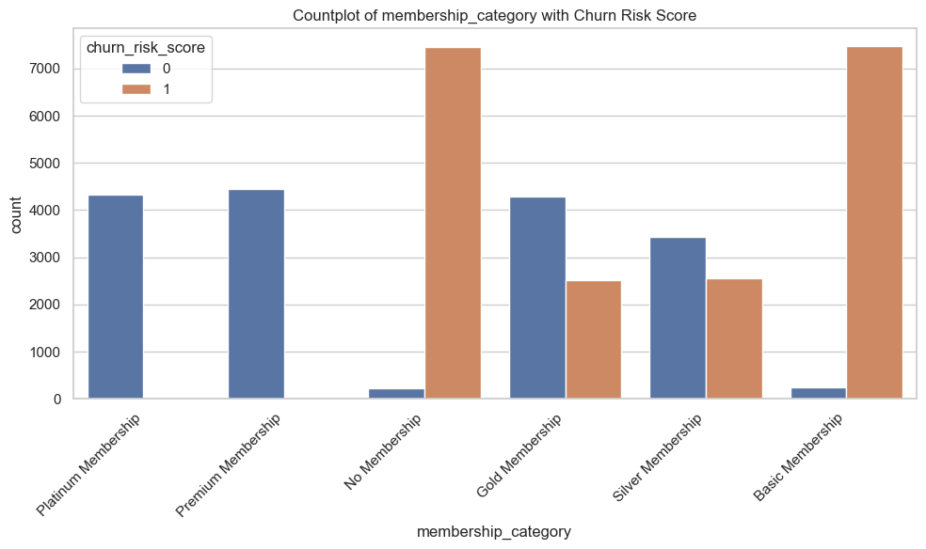
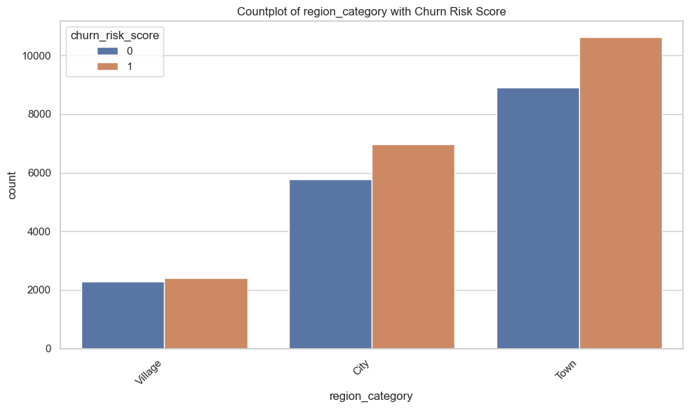



Slide 11
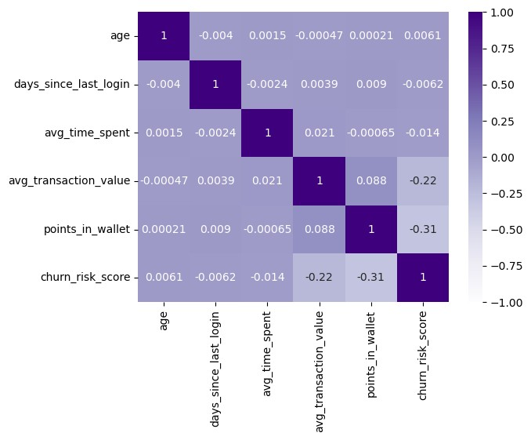


Finding Correlation using Heat Map

Slide 12
Handling Outliers
The Interquartile Range (IQR) method is used to detect and handle outliers.
A new data frame without outliers is created.
Min-Max scaling is applied to numerical features to bring them within a similar scale.
&
Feature Scaling

Slide 13
Insights
1) Most customers are Females belonging to Town
2)Most customers use a Desktop to access the website over Wi-Fi
3)Most of the customers have a Basic Membership of the service
4)Average age of customers who is likely to exit is 37
5)On average customers have around 680 points in their wallet
6)Maximum no. of days since a customer logged in is 26
7)There isn’t a high correlation between independent features and customer churn
8)Maximum -ve correlation between points in the wallet and customer churn is -0.31
9) second max -ve correlation is avg transaction value
10)As we can see both genders, Male and Female are equally distributed
11) Most of the customers are from town region while least number of customer belongs to village whcih is ~4600.
12)No membership and Basic category are leading one in membership_category while premium & platinum are least subscribed which is around ~4300+
13) Most of them have used special discount
14) Most of the customers has given negative feedback about the service such as poor website, poor customer service etc.

Slide 14


Slide 15
Model Training
Logistic Regression, Support Vector Machine (SVM), Naive Bayes, K-Nearest Neighbors (KNN), Decision Tree, and Random Forest classifiers are trained and evaluated.
The accuracy, confusion matrix, sensitivity, specificity, precision, recall, F-score, and AUC for each model are calculated and displayed.
Receiver Operating Characteristic (ROC) curves are plotted for each model.
& Evaluation

Slide 16
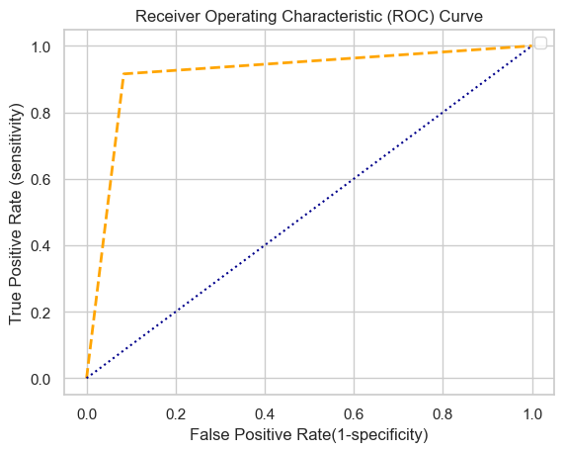
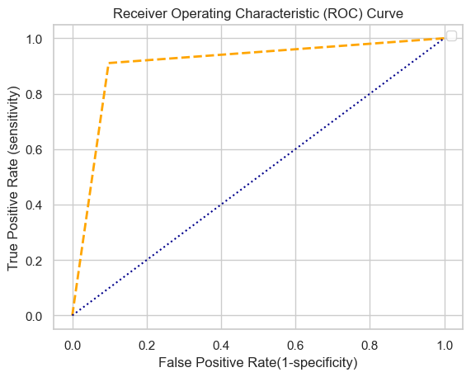

LOGISTIC REGRESSION
SUPPORT VECTOR MACHINE
Library used : sklearn.linear_model(LogisticRegression)
Split used for training and testing data:70,30
Library used :sklearn.svm(SVC)
Split used for training and testing data:70,30
Accuracy: 90.68
Sensitivity: 89.14
Specificity: 91.96
Precision: 90.23
Recall: 89.14
F score: 89.68
AUC: 90.64
Accuracy: 91.60
Sensitivity: 89.84
Specificity: 93.08
Precision: 91.65
Recall: 89.84
F score: 90.73
AUC: 91.60

Slide 17
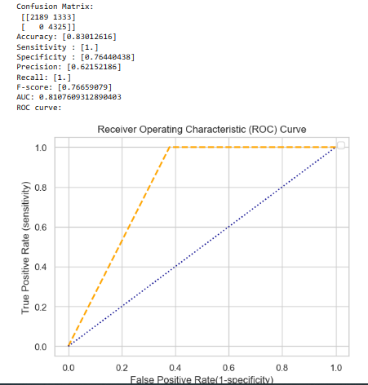
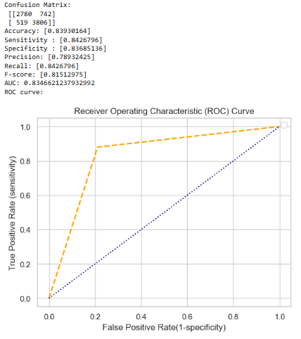
NAIVE BAYES ALGORITHM
KNN-k nearest neighbor

Slide 18
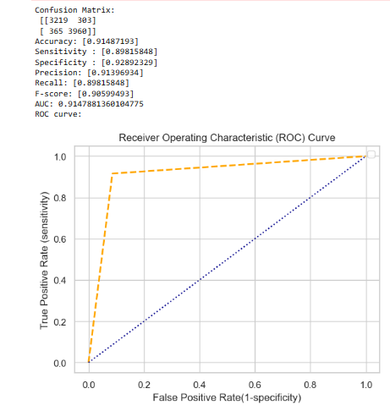
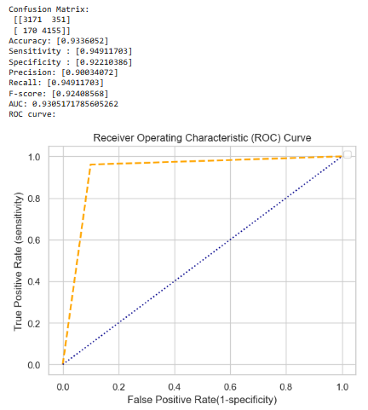
DECISION TREES
RANDOM FOREST

Slide 19
Model Comparison
The trained models are compared based on their accuracy.
The best-performing models are saved using the joblib library for future use.
Finally, the accuracy of each model is printed, providing a summary of how well each model performed in predicting customer churn.
& saving

Slide 20
Accuracy Comparison
Logistic_regression : Accuracy: 91.60
Svm_model: Accuracy: 90.68
Naive_bayes_model: Accuracy: 80.01
Knn_model: Accuracy: 83.93
Decision_tree_model: Accuracy: 91.48
Random_forest_model: Accuracy: 93.36

Slide 21
Model Accuracy Comparison
Logistic_regression : Accuracy: 91.60
Svm_model: Accuracy: 90.68
Naive_bayes_model: Accuracy: 80.01
Knn_model: Accuracy: 83.93
Decision_tree_model: Accuracy: 91.48
Random_forest_model: Accuracy: 93.36
Random_forest_model Accuracy has the highest accuracy among all the models

Slide 22





Thank you!
Prepared by:
ARUN KUMAR A R
EBEON0323790139
SOUMYA RANJAN
EBEON0323787472

